Slide 1
Billiards Simulation
P76044025 黃粲富
P76044059 張傑程
P76044449 林意瑄
P76044481 吳邦宇

Slide 2
Outline
Introduction
Physical System
Application-1
Application-2
Conclusion

Slide 3
Outline
Introduction
Physical System
Application-1
Application-2
Conclusion

Slide 4
Introduction
Goal
Create a pool ball games simulator
Using this simulator to do some application, such as searching best angle / force

Slide 5
Introduction
Environment
Unity Engine
C# programming language

Slide 6
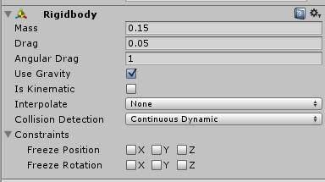
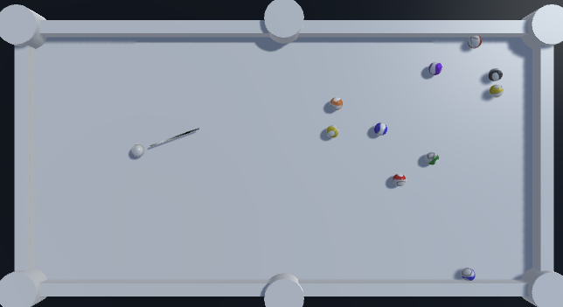
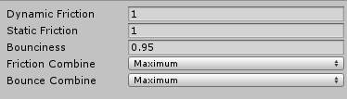
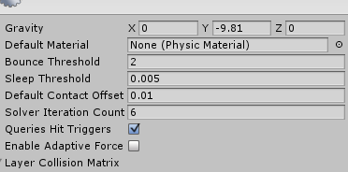
Introduction
Unity built-in physical system

Slide 7
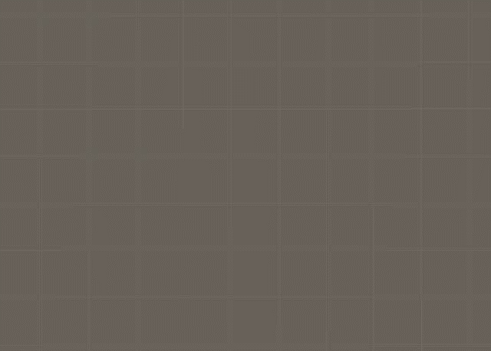
Introduction
Simulator based on Unity physical system

Slide 8
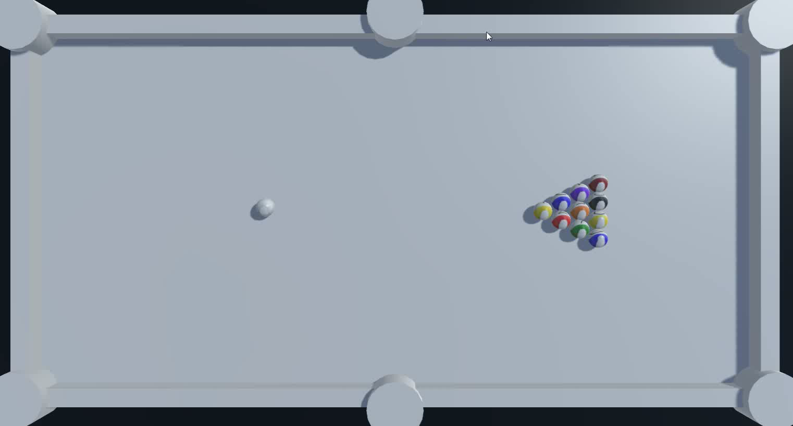
Introduction
Simulator based on our physical system

Slide 9
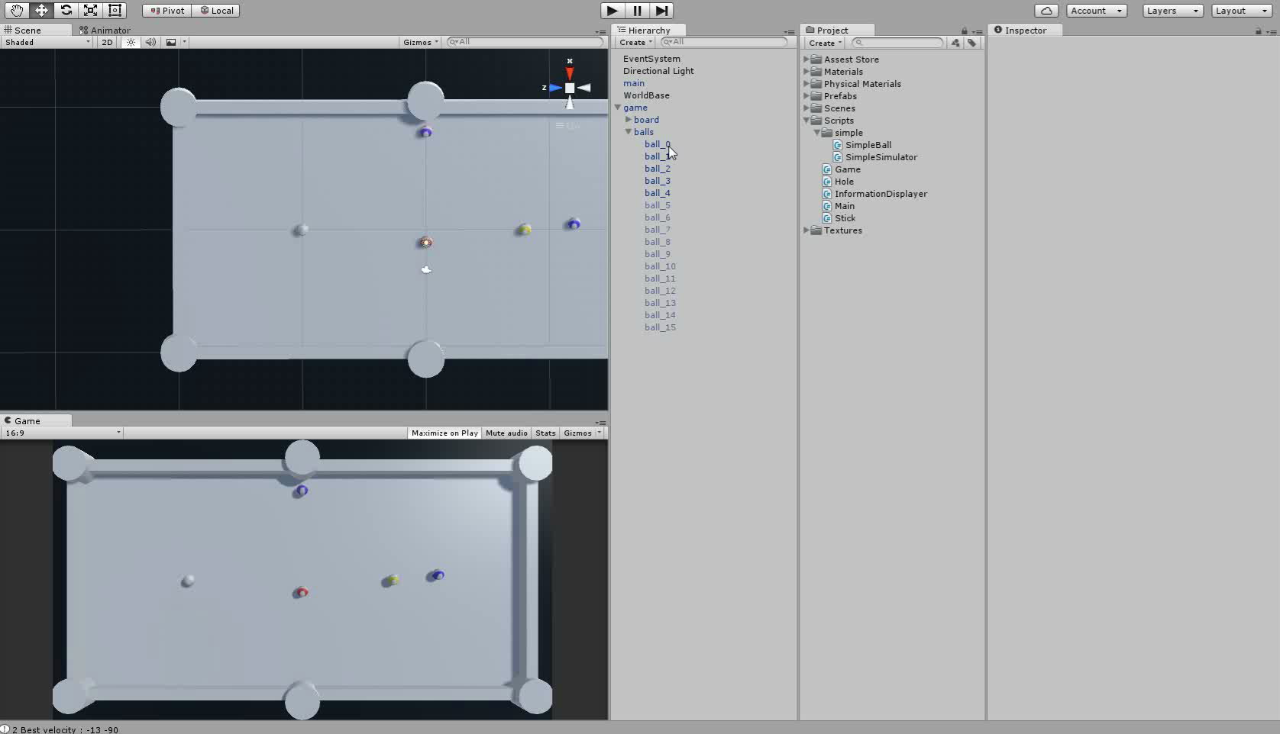
Introduction
Application

Slide 10
Outline
Introduction
Physical System
Application-1
Application-2
Conclusion

Slide 11

Physical System
$v_{1}=\frac{v_{1}\left(m_{1}−m_{2}\right)+2m_{2}v_{2}}{m_{1}+m_{2}}$
$v_{2}=\frac{v_{2}\left(m_{2}−m_{1}\right)+2m_{1}v_{1}}{m_{1}+m_{2}}$

Slide 12
Thank you for your attention
Reference
Strategic play for a pool-playing robot
T Nierhoff, K Heunisch, S Hirche - Advanced Robotics and its …, 2012 - ieeexplore.ieee.org
Object-oriented Simulation of Pool Ball Motion
AP Goldberg - 1987 - UCLA, Computer Science …
Realistic Billiards Simulation with Variable Time-Step
L Anderson

